Slide 1
BANK ANALYTICS BY GROUP-2
Presented By:
Ishika Kadam
Ipsita Puhan
Shailaja Kalle
Harshali Sonawane
Mangali Janardhan
Pyarla Kumar
Kuntimukkala Jeevan
Misriya M

Slide 2
Project Overview
This project transforms raw Finance data into actionable insights to support informed business decisions.
Objective: Analyze Finance data to derive business insights
Dataset size: 39,700+ records
Tools used: SQL, Excel, Tableau, Power BI

Slide 3
END-TO-END PROJECT WORKFLOW
This structured workflow ensured data accuracy and enabled reliable, actionable business insights.
Data Understanding
Data Cleaning & Transformation (Excel Power Query)
KPI Identification
Visualization & Dashboarding
Business Insights & Recommendations

Slide 4
OBJECTIVE
The objective of this project is to analyze the bank’s loan portfolio by distinguishing between reliable borrowers and those with higher default risk. It focuses on measuring profitability by comparing funded amounts with repayments and highlighting the role of interest income. The project also emphasizes selecting suitable KPIs and visualizations to present complex financial data in a clear and accessible way. Finally, the insights are delivered through interactive dashboards that support informed, data‑driven decisions.

Slide 5
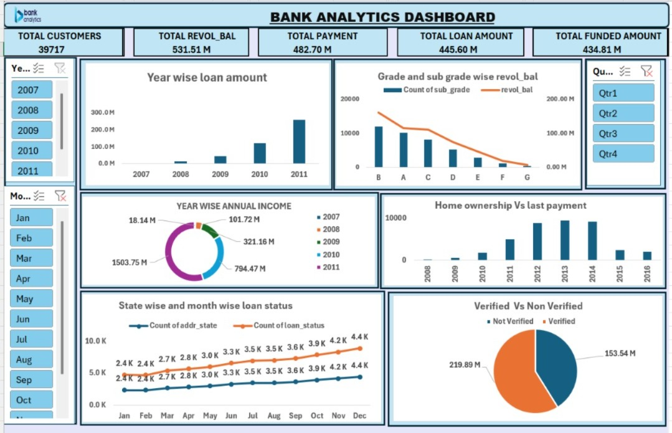
Excel Dashboard

Slide 6
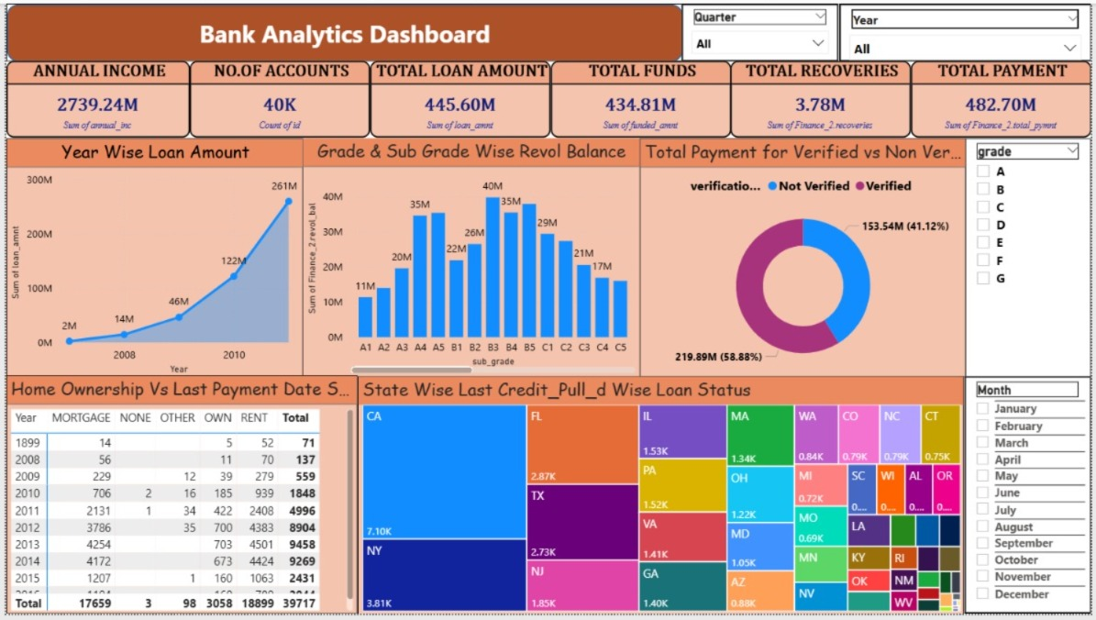
Powerbi Dashboard

Slide 7
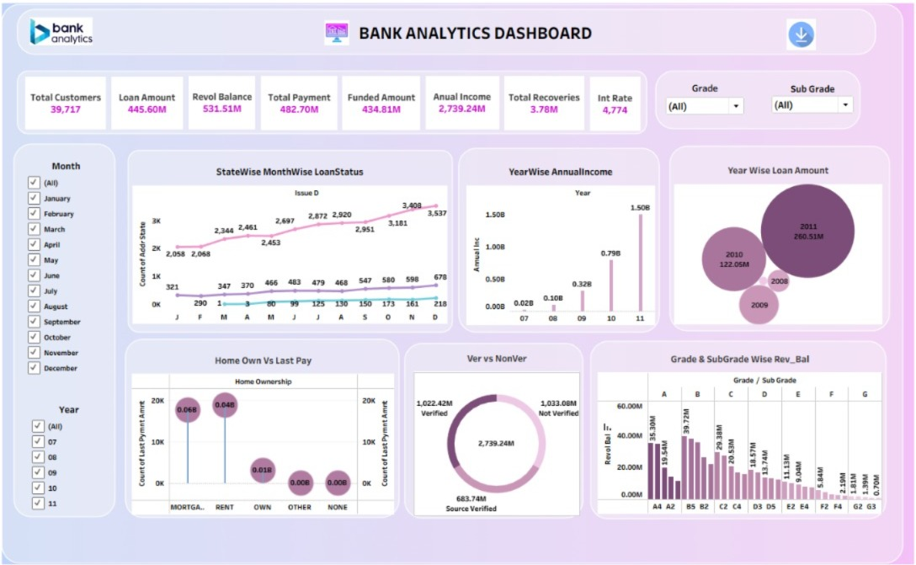
Tableau Dashboard

Slide 8
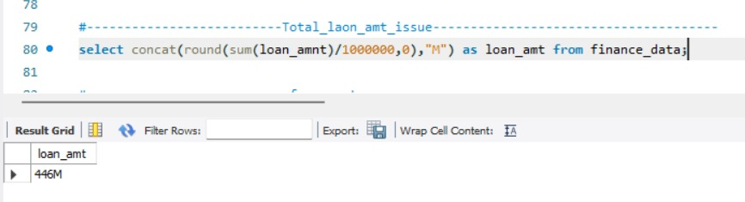
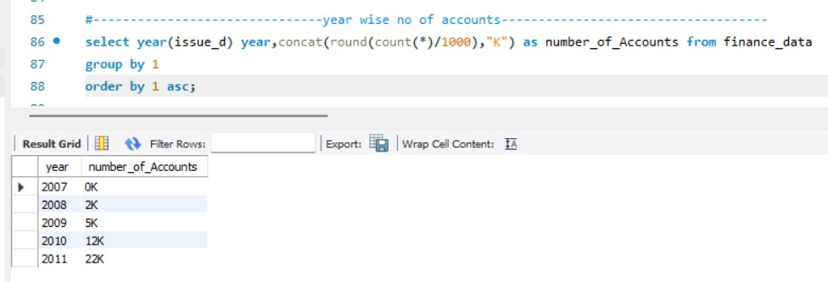
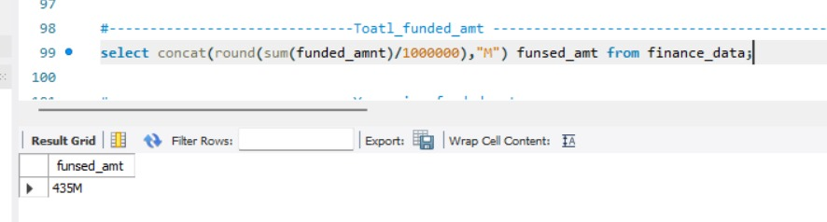
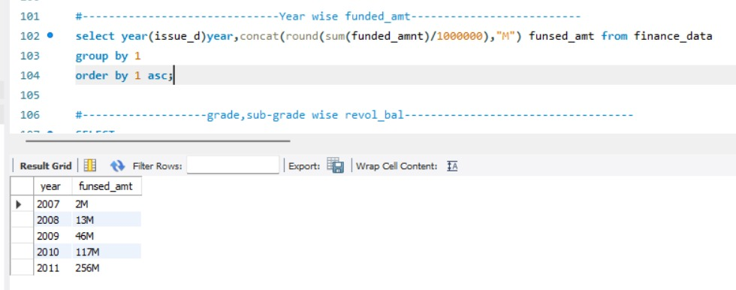
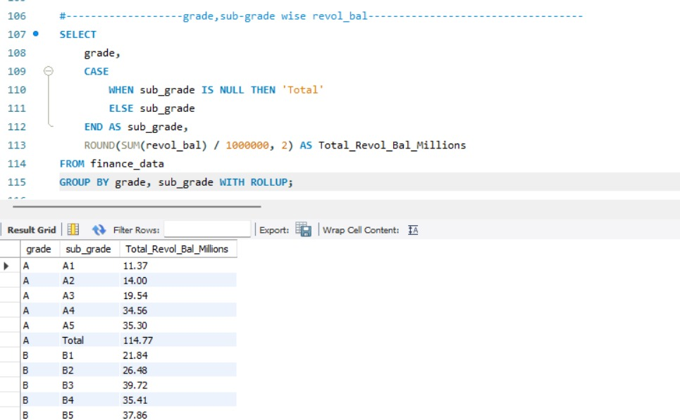
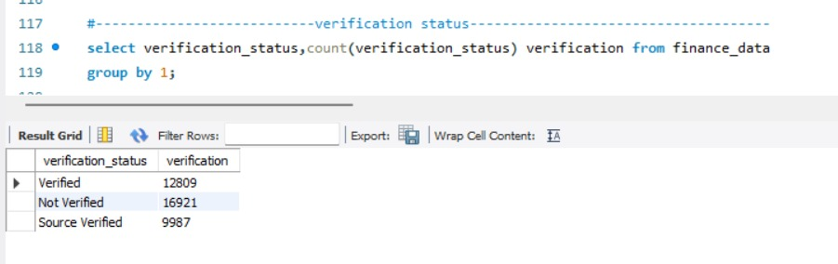
SQL KPI’S

Slide 9
CHALLENGES
Large Data Volume – Managing 39k+ loan records with multiple attributes required
efficient query design.
.
Data Cleaning in Power Query – Handling missing values and inconsistent formats
demanded careful preprocessing.
Dashboard Consistency – Ensuring KPIs aligned across Excel, Tableau, and Power BI
was a major integration challenge.
Fast Reporting Under Heavy Loads – Query optimization was essential to deliver timely insights
despite heavy datasets.
Picking Suitable Charts – Selecting the right visualization to represent KPIs clearly for
both technical and non‑technical audiences.

Slide 10
KPI’s :
Total Customers : The number of unique customers served by the bank.
Insight: A growing customer base signals market expansion and stronger brand trust.
Total Amount : The overall loan amount disbursed to customers.
Insight: Rising totals indicate increasing demand for credit and portfolio growth.
Revolving Balance : The outstanding balance customers carry on revolving credit.
Insight: High balances highlight ongoing credit usage and repayment dependency.
Total Payment : The cumulative payments made by customers toward loans.
Insight: Increasing payments reflect healthy repayment behavior and reduced default risk.
Annual Income : The reported yearly income of customers.
Insight: Higher incomes correlate with stronger repayment capacity and lower risk exposure.

Slide 11
Final Insights
In summary my dashboard shows :
Loan amount increases every year
Grade B,C,D have more balance
Verified customers pay more
Some States have better loan performance
Mortgage and rent customers make more payments

Slide 12
Key Learnings from the Project
This project strengthened our ability to approach data problems from raw data to actionable business insights.
Handling raw data efficiently
Selecting meaningful KPIs
Choosing the right visualization
Converting data into business insights
End-to-end analytical thinking

Slide 13
Conclusion
This project demonstrates how loan and customer data can be transformed into actionable KPIs that help banks improve credit risk management, optimize lending strategies, and enhance portfolio performance.

Slide 14
Thankyou

